Slide 1


PRANAV LENIN
31/3/2025

Slide 2

Outline
Executive Summary
Introduction
Methodology
Results
Conclusion
Appendix

Slide 3
Executive Summary
Summary of methodologies
Summary of all results

Slide 4
Introduction
Questions to be answered :
What Data is needed for this prediction?
Where will the data will be collected from?
What features are required for the prediction?
Which algorithms are best suited for this problem?
What evaluation metric should I use?
How will I handle overfitting or underfitting?
How often should the model be updated?
This project is about SpaceX rocket landing prediction. This will be predicting the answer of : Will this SpaceX rocket land successfully or not?

Slide 5

Section 1

Slide 6
Methodology
Executive Summary
Data collection methodology:
The data was collected form "https://cf-courses-data.s3.us.cloud-object-storage.appdomain.cloud/IBM-DS0321EN-SkillsNetwork/datasets/dataset_part_2.csv"
Perform data wrangling
The data was encoded and refined by dropping the unwanted columns.
Perform exploratory data analysis (EDA) using visualization and SQL
Perform interactive visual analytics using Folium and Plotly Dash
Perform predictive analysis using classification models
How to build, tune, evaluate classification models

Slide 7
Data Collection
The data was collected from the IBM database about the rocket launches of SPACEX. It is a JSON file format which is then converted into data frame by pandas.
response=requests.get(static_json_url)
df = response.json()
data = pd.json_normalize(df)

Slide 8
Data Collection – SpaceX API
Present your data collection with SpaceX REST calls using key phrases and flowcharts
Add the GitHub URL of the completed SpaceX API calls notebook (must include completed code cell and outcome cell), as an external reference and peer-review purpose
response=requests.get(static_json_url)
df = response.json()
data = pd.json_normalize(df)

Slide 9
Data Collection - Scraping
I Web Scraped from :- “https://en.wikipedia.org/w/index.php?title=List_of_Falcon_9_and_Falcon_Heavy_launches&oldid=1027686922”
response = requests.get(static_url)
soup = BeautifulSoup(response.text, "html.parser")
tables = soup.find_all("table", {"class": "wikitable"})

Slide 10
Data Wrangling
The SpaceX rocket launch data was collected and cleaned by handling missing values, removing duplicates, and fixing data types. Categorical variables like LaunchSite, Orbit, and LandingPad were encoded using pd.get_dummies(), while numerical features like PayloadMass(kg) were scaled. The dataset was split into training and testing sets, ensuring no data leakage. Finally, the processed data was used to train machine learning models to predict the success of rocket landings. Git hub link:’ https://labs.cognitiveclass.ai/v2/tools/jupyterlab?ulid=ulid-d8f550da53a199b98550928754ae733955db18ec’

Slide 11
EDA with Data Visualization
Bar Chart – Used to compare the success rate of launches across different launch sites.
Scatter Plot – Plotted FlightNumber vs. PayloadMass(kg) to analyze the impact of payload on landing success.
Catplot – Displayed FlightNumber vs. LaunchSite with hue as Class to visualize the distribution of successful and failed landings.
Pie Chart – Showed the proportion of successful vs. failed launches for an overall success rate analysis.
Box Plot – Used to detect outliers and analyze the distribution of PayloadMass(kg) across different orbits.
GITHUB LINK:” https://labs.cognitiveclass.ai/v2/tools/jupyterlab?ulid=ulid-3950bf2f61f89c02c297b52a2ef57061beb5053d”

Slide 12
Build an Interactive Map with Folium
Folium Map Objects and Their Purpose
Markers – Placed at each SpaceX launch site to pinpoint their exact locations.
Circles – Added around launch sites to highlight their geographical areas.
Lines (Polylines) – Drawn to show distances between launch sites and key locations (e.g., headquarters or landing zones).
Popups – Included additional details about each launch site when clicked.
These objects were added to provide an interactive visualization of SpaceX launch sites, helping to analyze their locations and surroundings effectively.
GITHUB LINK-” https://labs.cognitiveclass.ai/v2/tools/jupyterlab?ulid=ulidd8f550da53a199b98550928754ae733955db18ec”

Slide 13
Build a Dashboard with Plotly Dash
Bar Chart – Displays the success count of launches for each launch site to compare performance.
Scatter Plot – Shows the relationship between PayloadMass(kg) and success rate, helping to analyze the impact of payload size.
Pie Chart – Visualizes the proportion of successful vs. failed landings for overall mission success analysis.
Line Chart – Represents trends in launch success over time.

Slide 14
Predictive Analysis (Classification)
Data Preprocessing – Cleaned missing values, encoded categorical variables (Orbit, LaunchSite), and scaled numerical features (PayloadMass(kg)).
Model Selection – Tested multiple classification models, including Logistic Regression, Support Vector Machine (SVM), Decision Tree, and Random Forest.
Evaluation – Used accuracy, precision, recall, and F1-score to compare model performance.
Hyperparameter Tuning – Applied GridSearchCV and RandomizedSearchCV to optimize parameters for better accuracy.
Best Model Selection – Found that SVM with an RBF kernel performed best on the validation dataset
Preprocessed Data
Train Multiple Classifiers
Evaluate Models
Hyperparameter Tuning
Train-Test Split (80-20)

Slide 15
Results
Exploratory data analysis results
Interactive analytics demo in screenshots
Predictive analysis results

Slide 16

Section 2

Slide 17
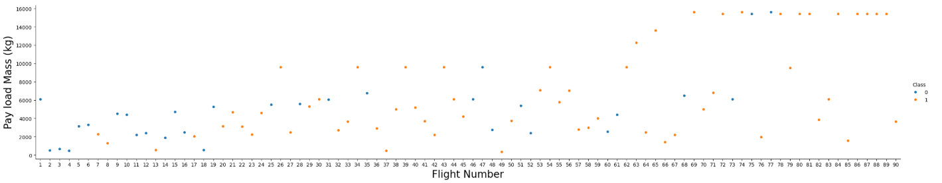
Flight Number vs. Launch Site

Slide 18
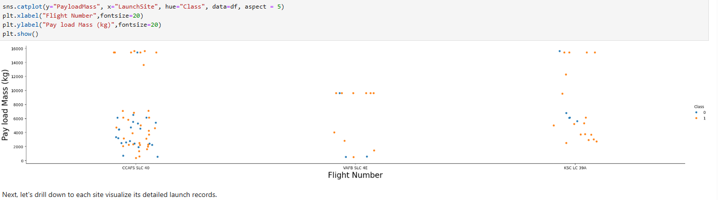
Payload vs. Launch Site

Slide 19
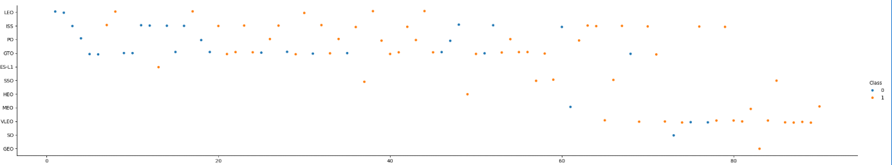
Flight Number vs. Orbit Type

Slide 20
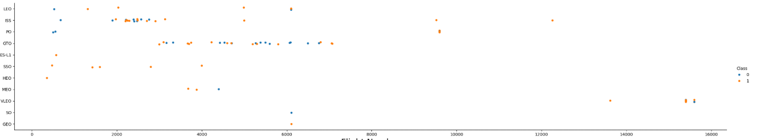
Payload vs. Orbit Type

Slide 21
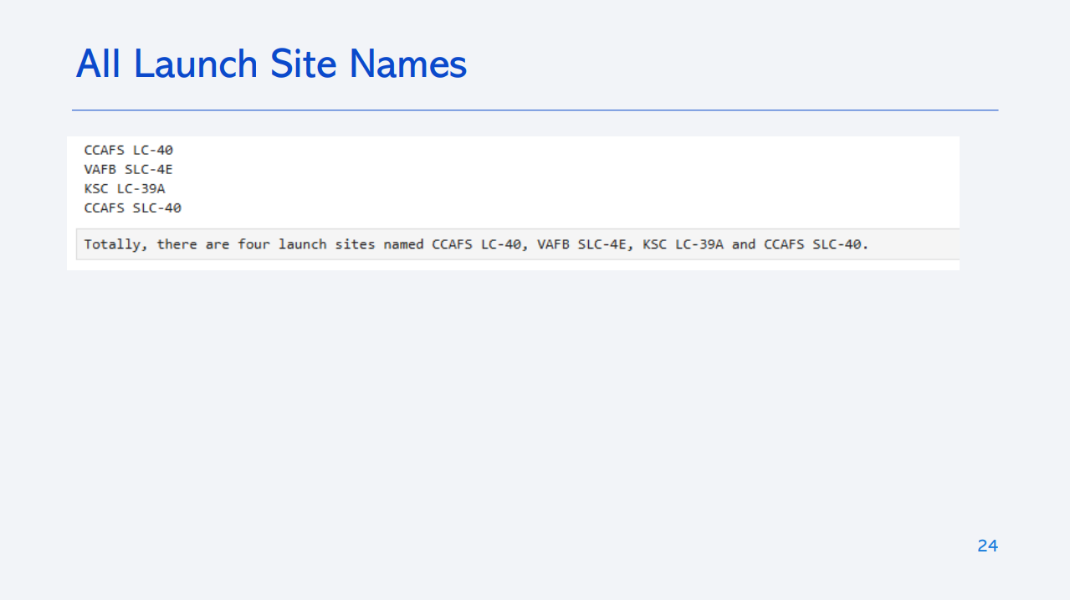
All Launch Site Names
CCAFS SLC 40 , VAFB SLC 4E , KSC LC 39A, CCAFS LC-13, Boca Chica
df['LaunchSite'].unique()

Slide 22
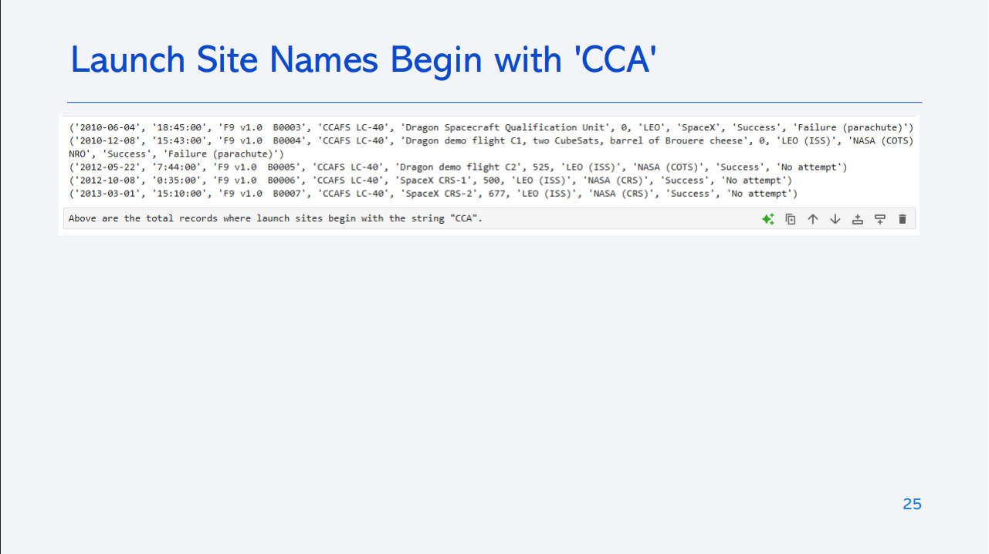
Launch Site Names Begin with 'CCA'
CCAFS LC-13 , CCAFS SLC-40

Slide 23
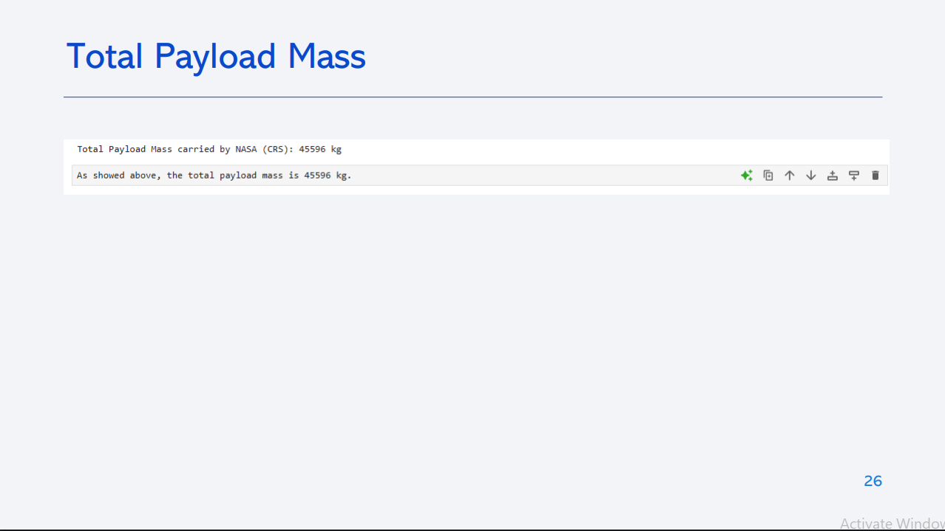
Total Payload Mass
549446.3470588236
df['PayloadMass'].sum()

Slide 24
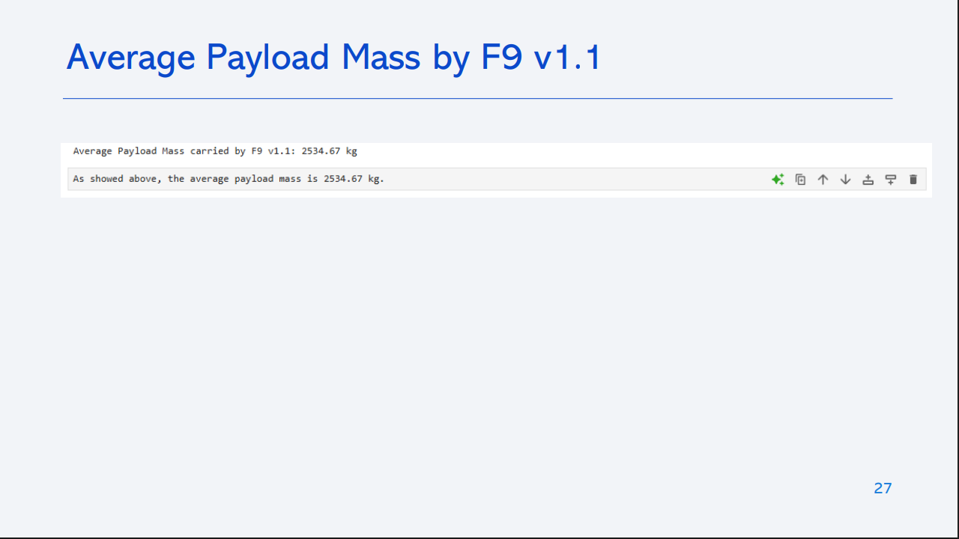
Average Payload Mass by F9 v1.1
6104.95941
df['PayloadMass'].mean()

Slide 25
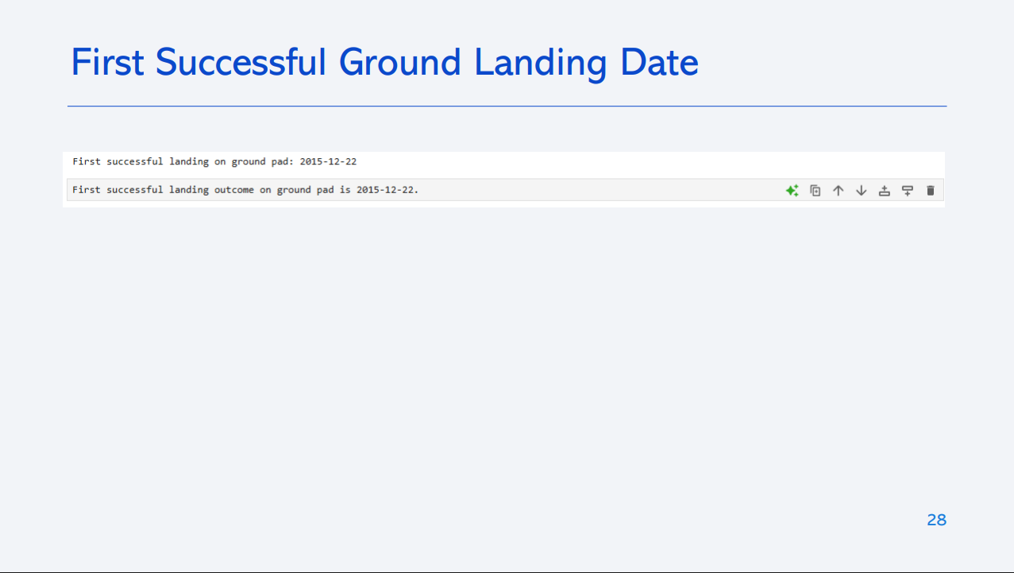
First Successful Ground Landing Date
December 21, 2015

Slide 26
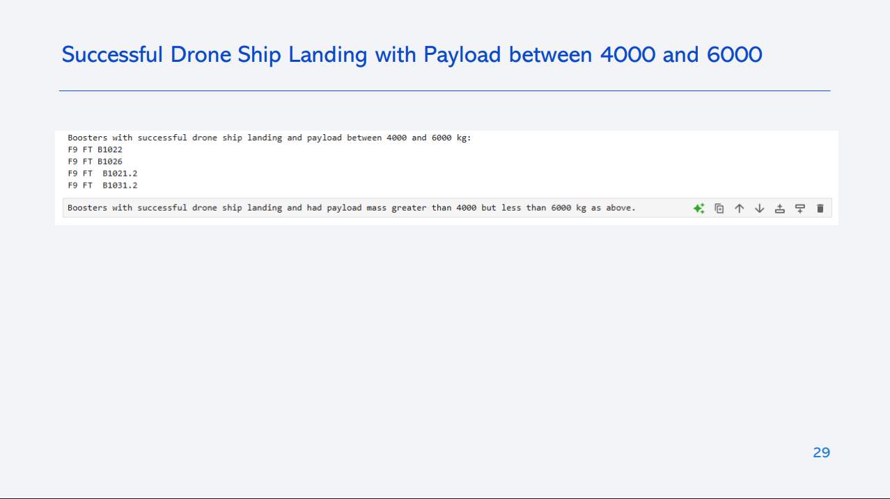
Successful Drone Ship Landing with Payload between 4000 and 6000
List the names of boosters which have successfully landed on drone ship and had payload mass greater than 4000 but less than 6000
Present your query result with a short explanation here

Slide 27
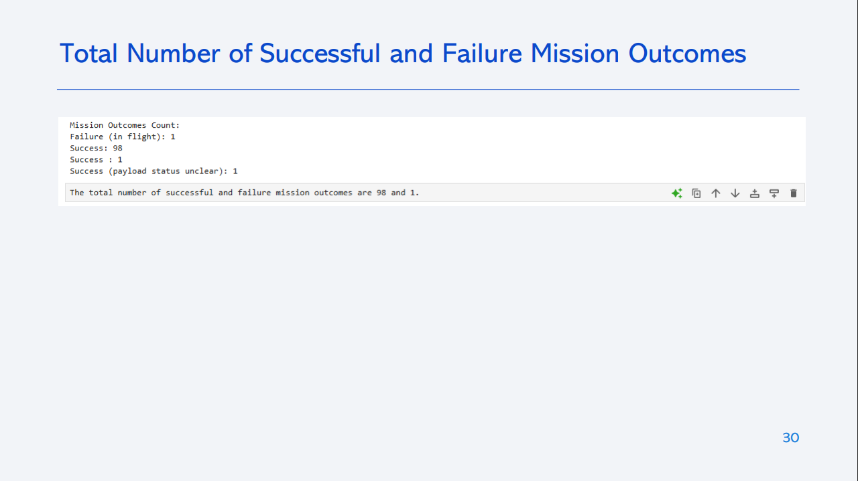
Total Number of Successful and Failure Mission Outcomes
Calculate the total number of successful and failure mission outcomes
Present your query result with a short explanation here

Slide 28
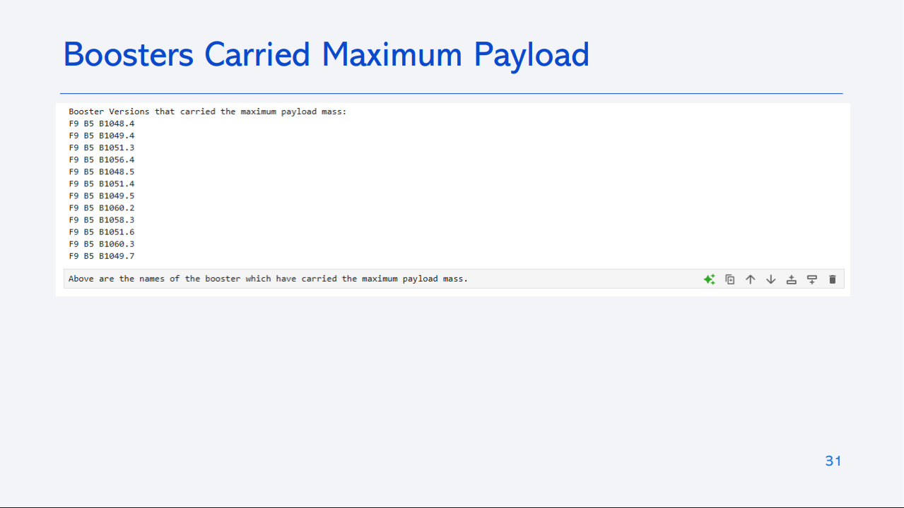
Boosters Carried Maximum Payload
List the names of the booster which have carried the maximum payload mass
Present your query result with a short explanation here

Slide 29
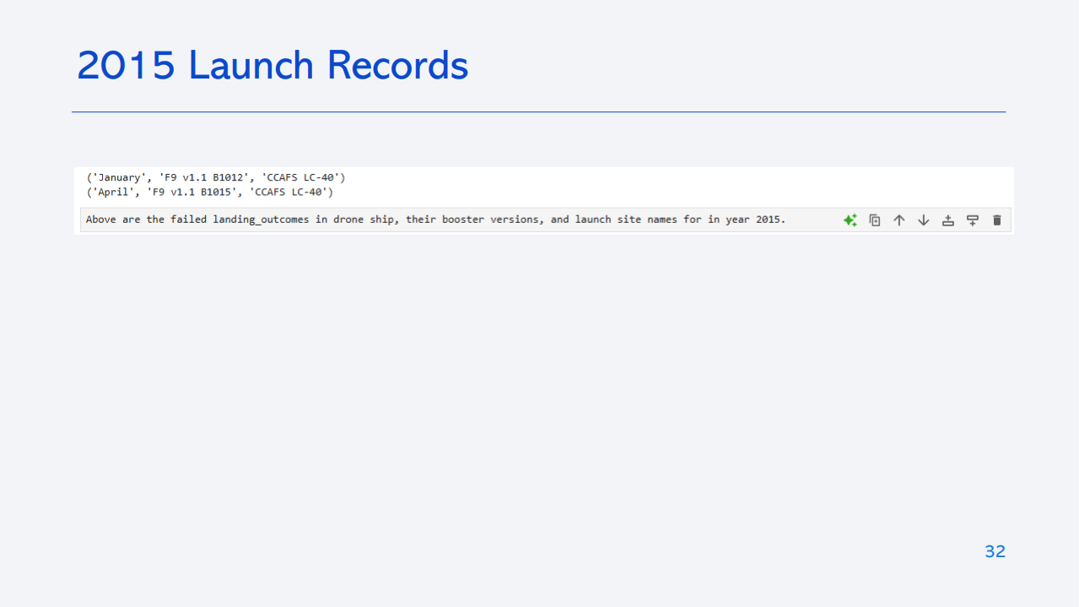
2015 Launch Records
List the failed landing_outcomes in drone ship, their booster versions, and launch site names for in year 2015
Present your query result with a short explanation here

Slide 30
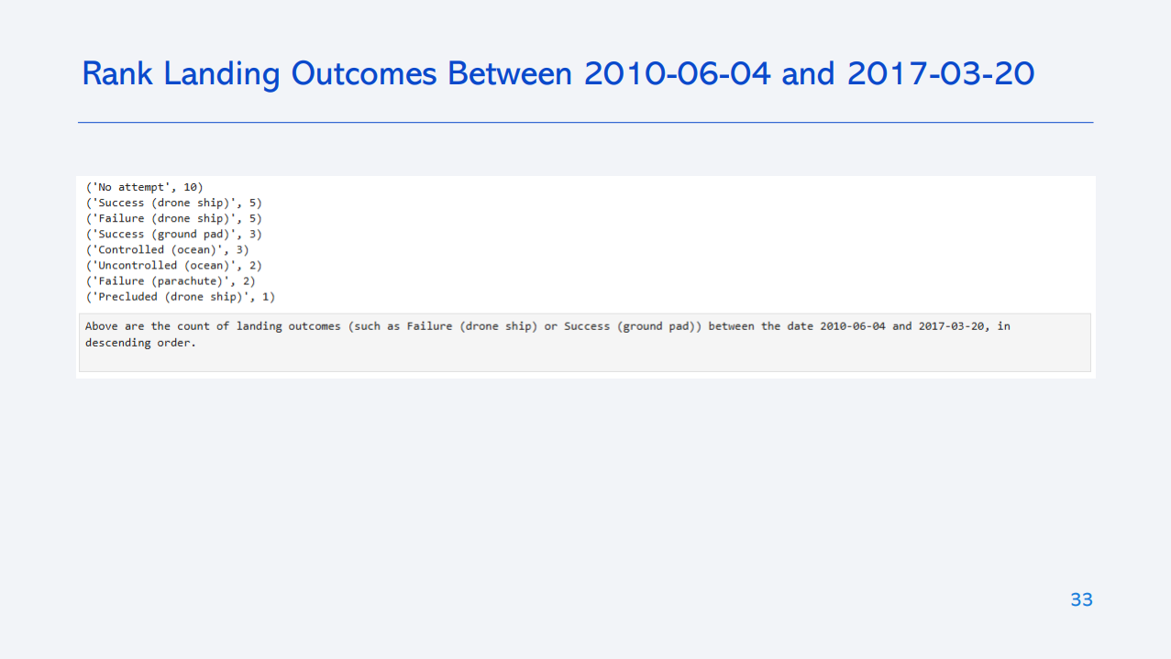
Rank Landing Outcomes Between 2010-06-04 and 2017-03-20
Rank the count of landing outcomes (such as Failure (drone ship) or Success (ground pad)) between the date 2010-06-04 and 2017-03-20, in descending order
Present your query result with a short explanation here

Slide 31

Section 3

Slide 32
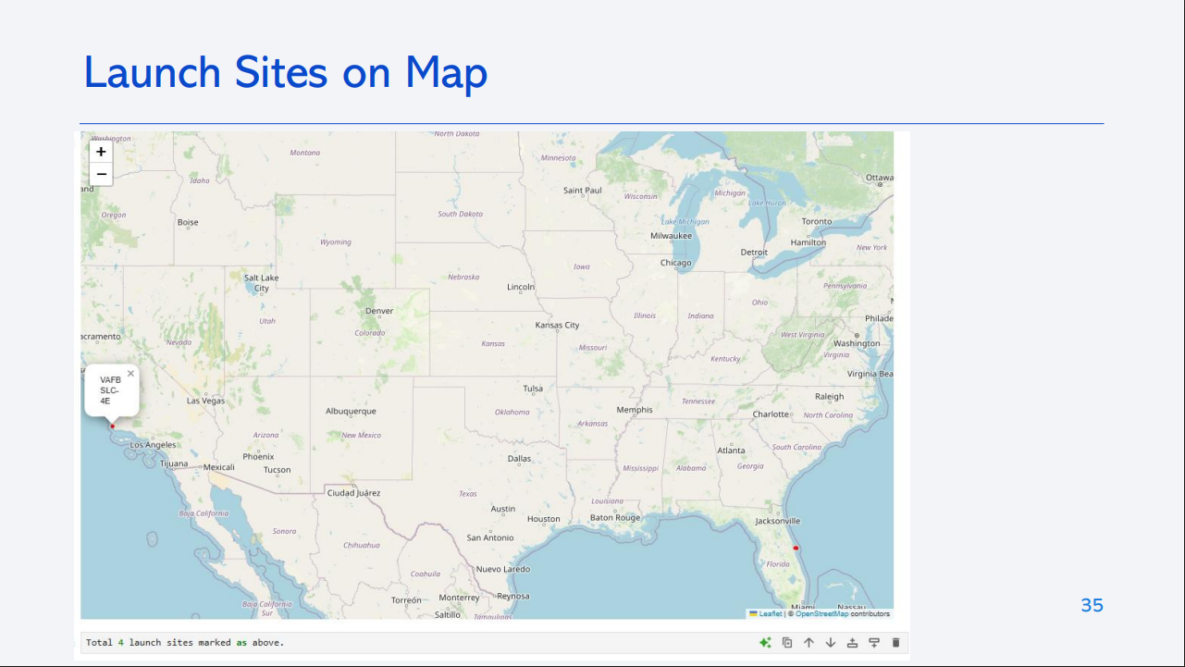
<Folium Map Screenshot 1>
Replace <Folium map screenshot 1> title with an appropriate title
Explore the generated folium map and make a proper screenshot to include all launch sites’ location markers on a global map
Explain the important elements and findings on the screenshot

Slide 33
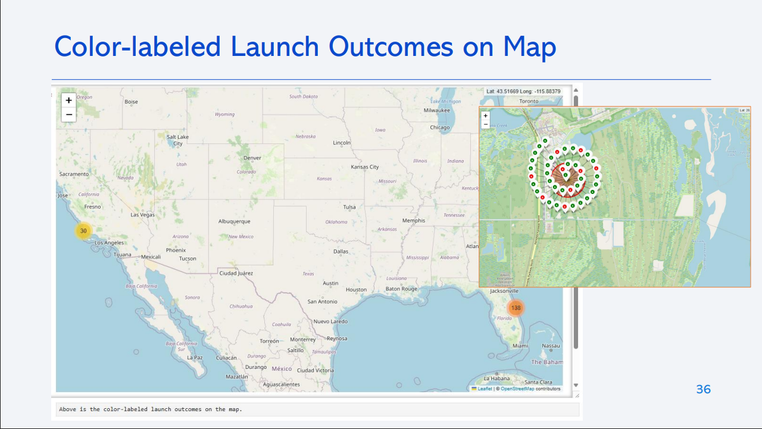
<Folium Map Screenshot 2>
Replace <Folium map screenshot 2> title with an appropriate title
Explore the folium map and make a proper screenshot to show the color-labeled launch outcomes on the map
Explain the important elements and findings on the screenshot

Slide 34
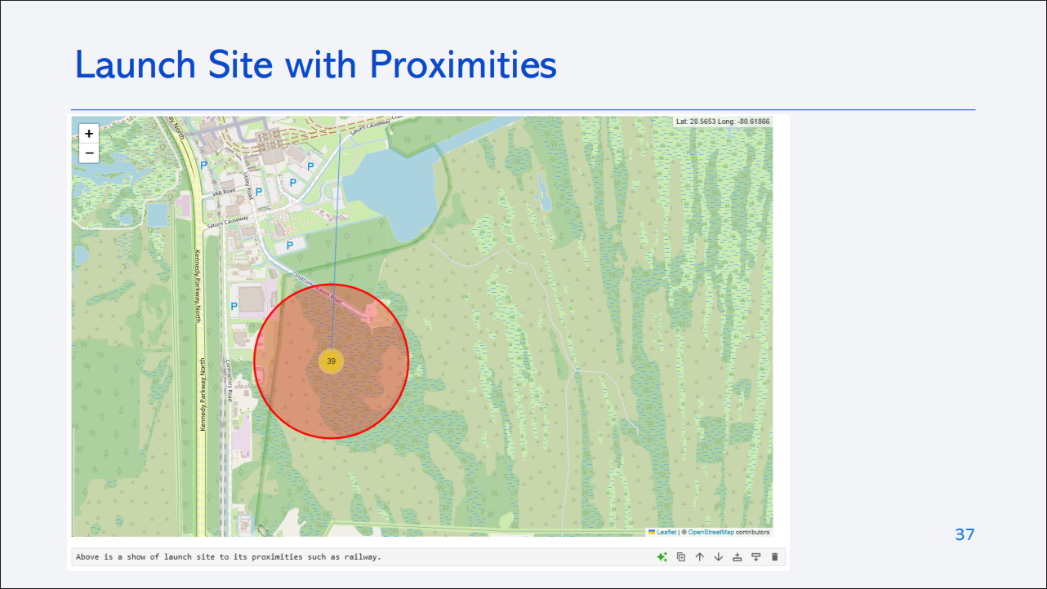
<Folium Map Screenshot 3>
Replace <Folium map screenshot 3> title with an appropriate title
Explore the generated folium map and show the screenshot of a selected launch site to its proximities such as railway, highway, coastline, with distance calculated and displayed
Explain the important elements and findings on the screenshot

Slide 35

Section 4

Slide 36
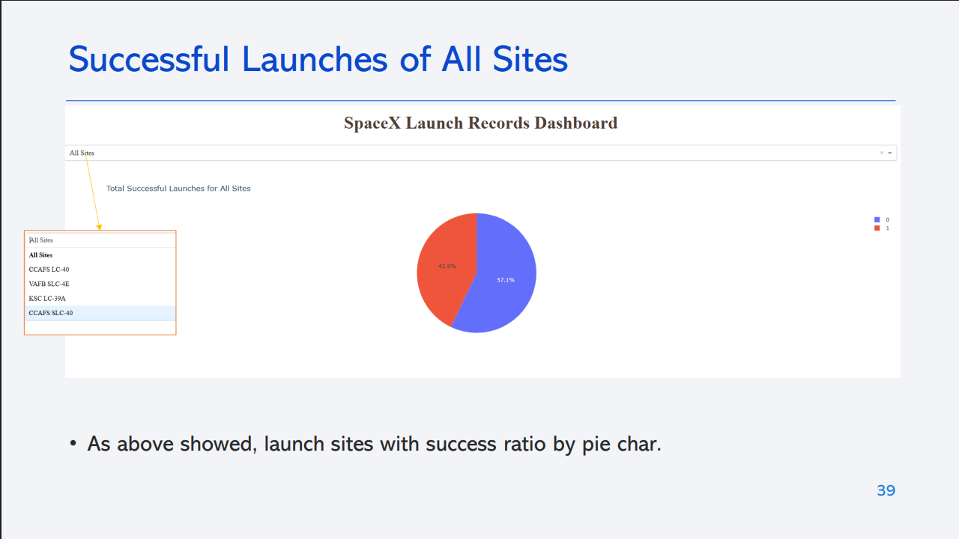
<Dashboard Screenshot 1>
Replace <Dashboard screenshot 1> title with an appropriate title
Show the screenshot of launch success count for all sites, in a piechart
Explain the important elements and findings on the screenshot

Slide 37
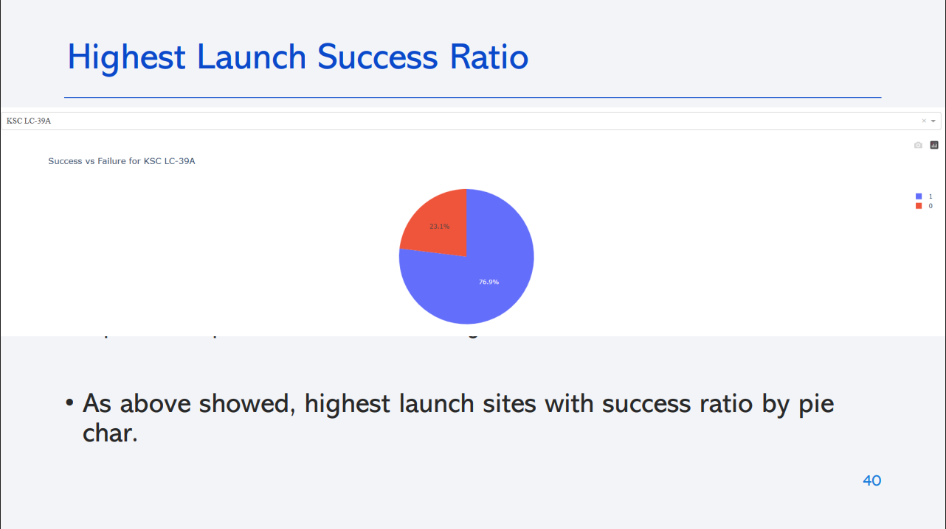
<Dashboard Screenshot 2>
Replace <Dashboard screenshot 2> title with an appropriate title
Show the screenshot of the piechart for the launch site with highest launch success ratio
Explain the important elements and findings on the screenshot

Slide 38
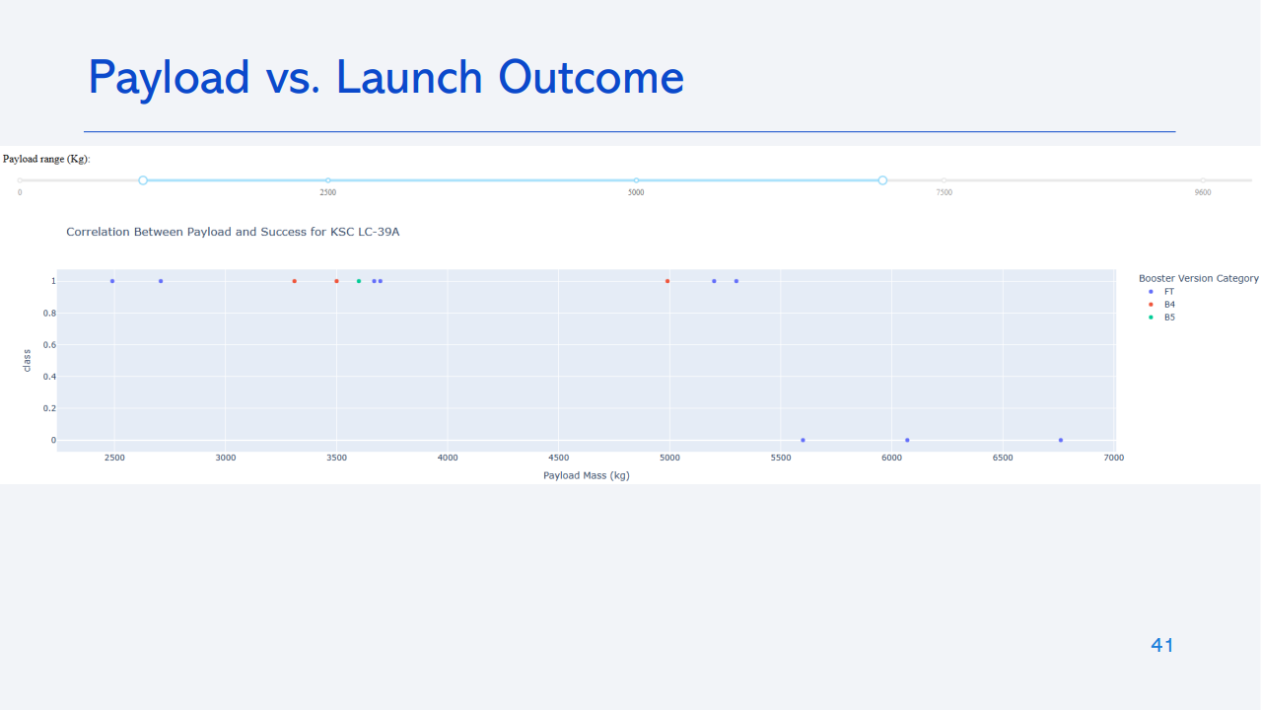
<Dashboard Screenshot 3>
Replace <Dashboard screenshot 3> title with an appropriate title
Show screenshots of Payload vs. Launch Outcome scatter plot for all sites, with different payload selected in the range slider
Explain the important elements and findings on the screenshot, such as which payload range or booster version have the largest success rate, etc.

Slide 39

Section 5

Slide 40
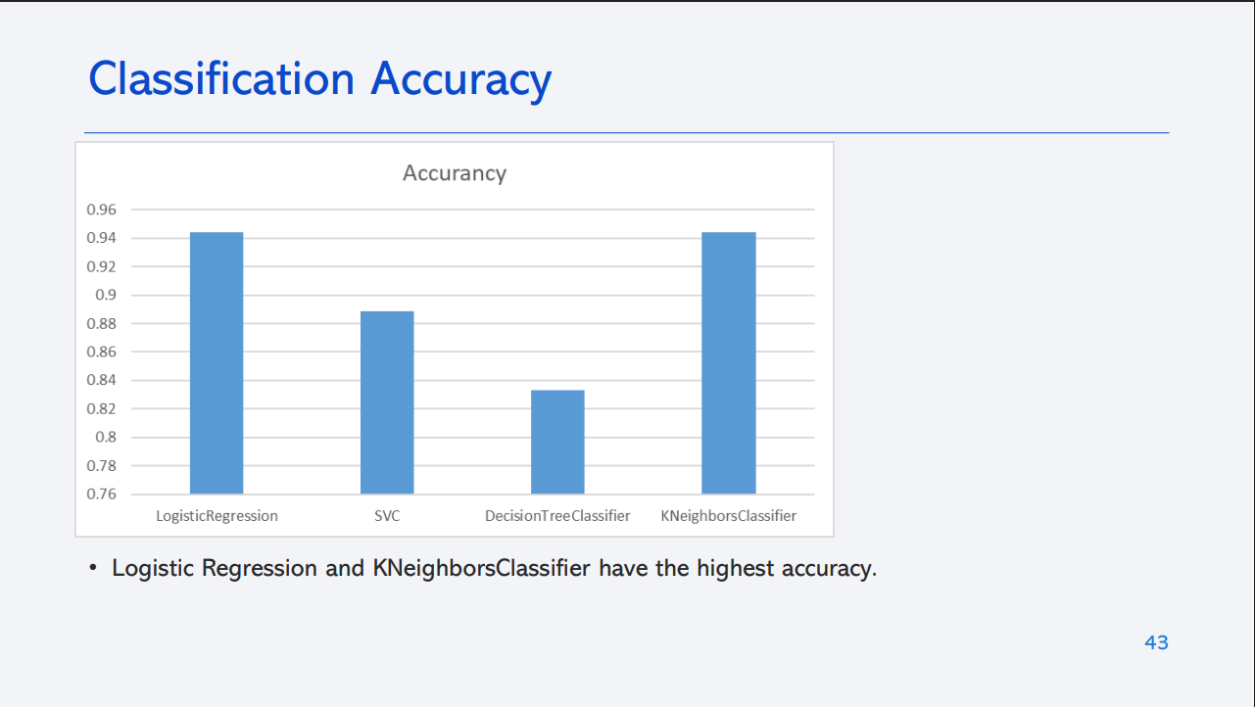
Classification Accuracy
Visualize the built model accuracy for all built classification models, in a bar chart
Find which model has the highest classification accuracy

Slide 41
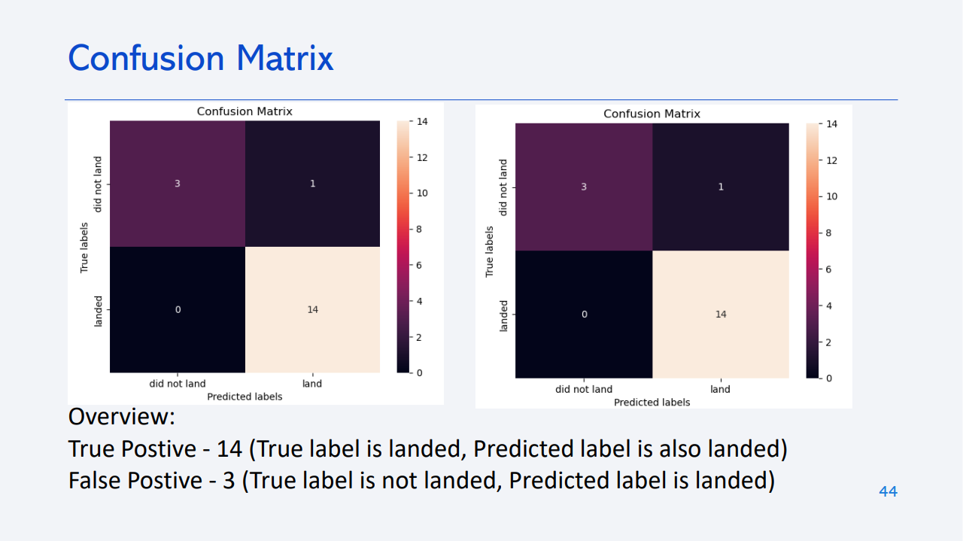
Confusion Matrix
Show the confusion matrix of the best performing model with an explanation

Slide 42
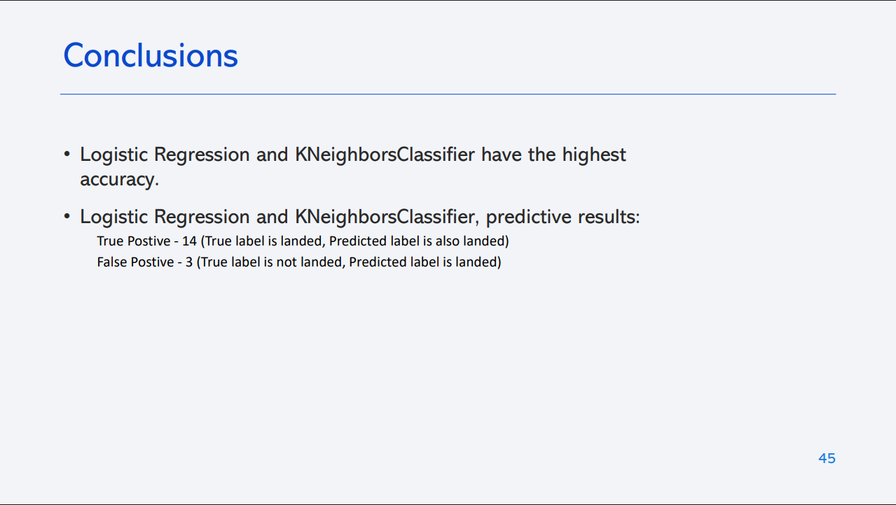
Conclusions
Point 1
Point 2
Point 3
Point 4
…

Slide 43
Appendix
Include any relevant assets like Python code snippets, SQL queries, charts, Notebook outputs, or data sets that you may have created during this project

Slide 44


